Slide 1


PITHIA-NRF Automatically publishing the schema
Dimitris Kagialis – University of Westminster
11.07.2022

Slide 2
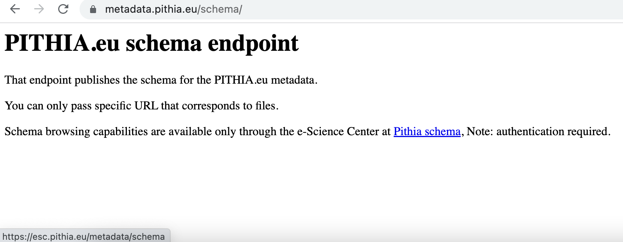
Schema URL
Publishing URL: https://metadata.pithia.eu/schema/
Sample welcome page:
Note: possible browsing URL

Slide 3
Schema process architecture
Create /
Modify /
Delete actions
GitHub Schema repo
GitHub Actions
metadata@vm3.pithia.eu
Path: /home/metadata/schema
Trigger update
Action on push
SSH on host and
Pull new updates
Schema
maintainer
Monitor Create, Modify, Delete actions
metadata@vm3.pithia.eu
Background process with inotifywait
Create /
Modify /
Delete captured
metadata@vm3.pithia.eu
File deleted/updated at
/var/www/pithia.eu/html/schema
metadata@vm3.pithia.eu
NGINX publishes at https://metadata.pithia.eu/schema
the folder /var/www/pithia.eu/html/schema
https://metadata.pithia.eu/schema/file
Schema
Request

Slide 4
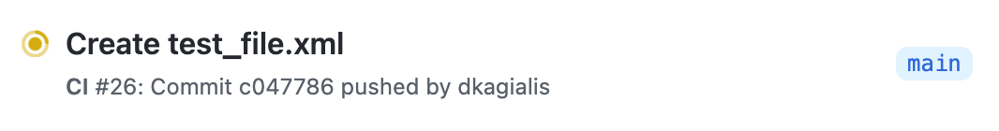
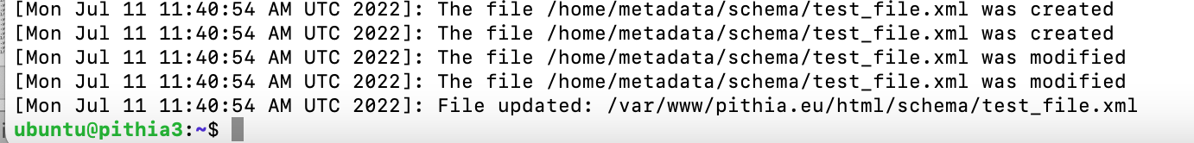
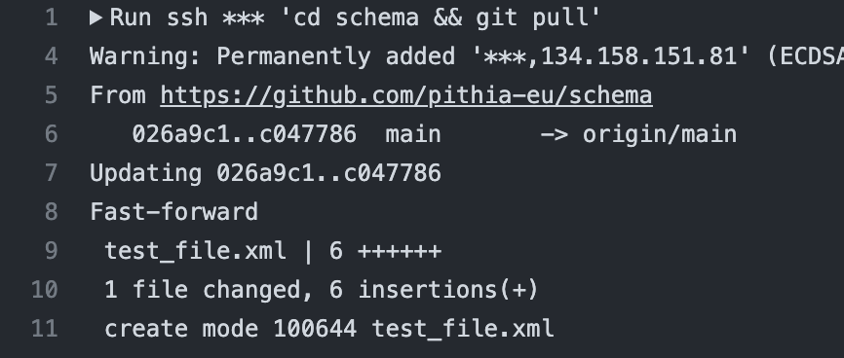
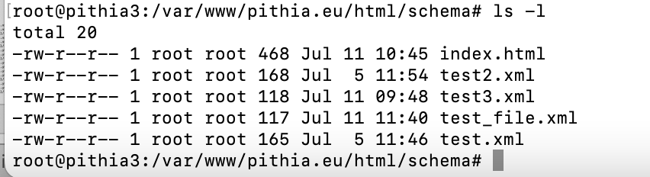
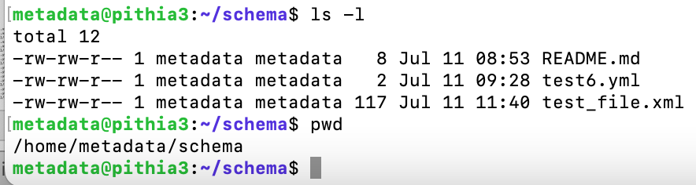
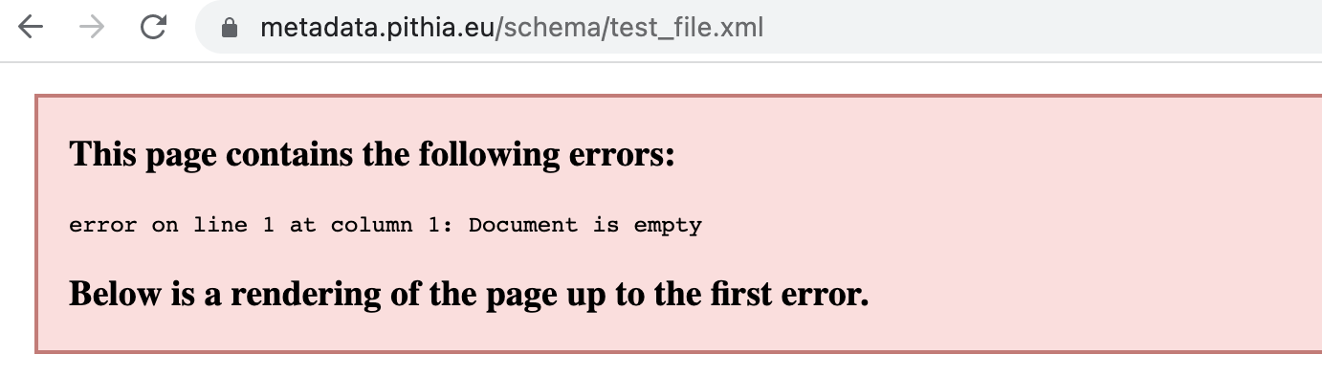
Demo – creating a file
1 add a file test_file.xml and initiate the action
4 the monitoring process detects the new file and copies it to schema www folder
2 the action updates the repo on vm3.pithia.eu
5 the file now is in the schema www folder
3 test_file.xml created in the local repo
6 a user can now go and see the file (Note the file has an error, let’s fix it in the next slide)

Slide 5
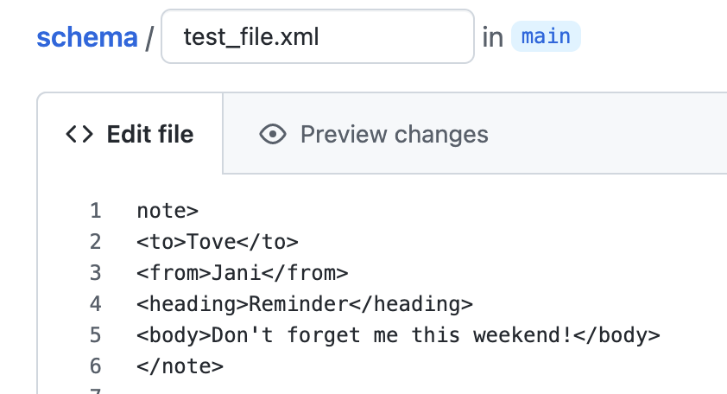
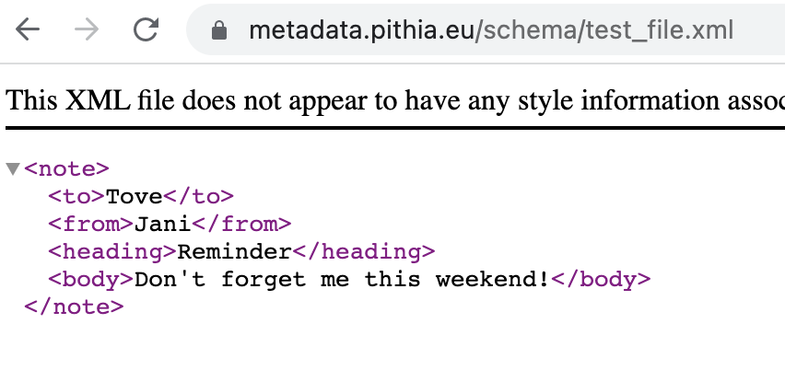
Demo – udpating a file
1 The file test_file.xml had a typo.
2 A quick edit and commit initiates the process and now the files
is being published as excepted.
error

Slide 6
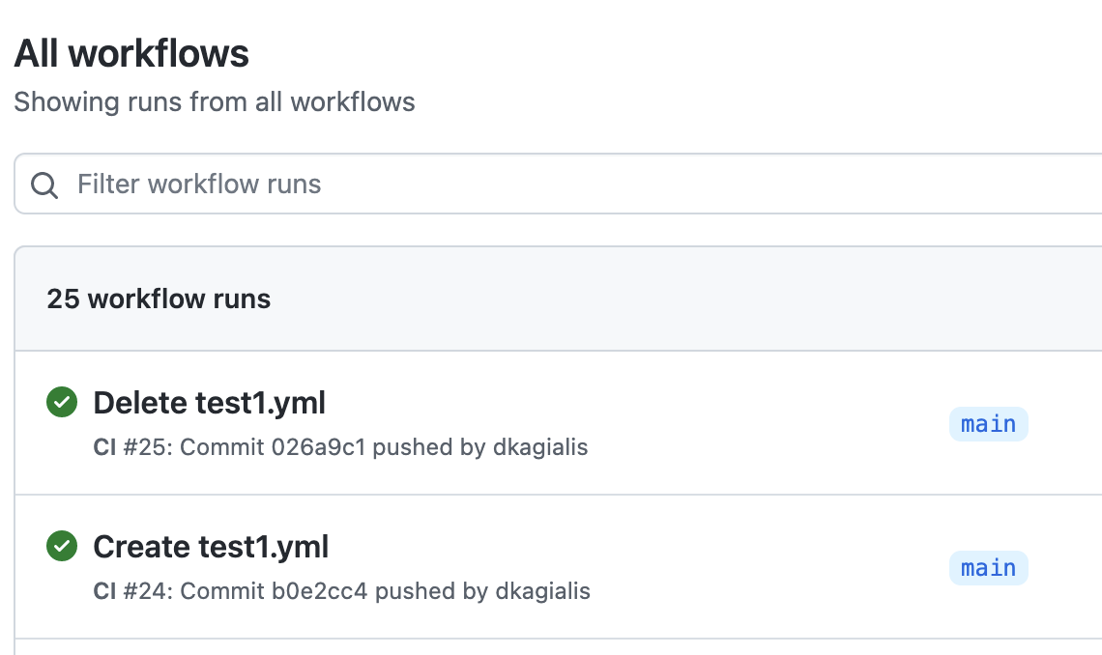
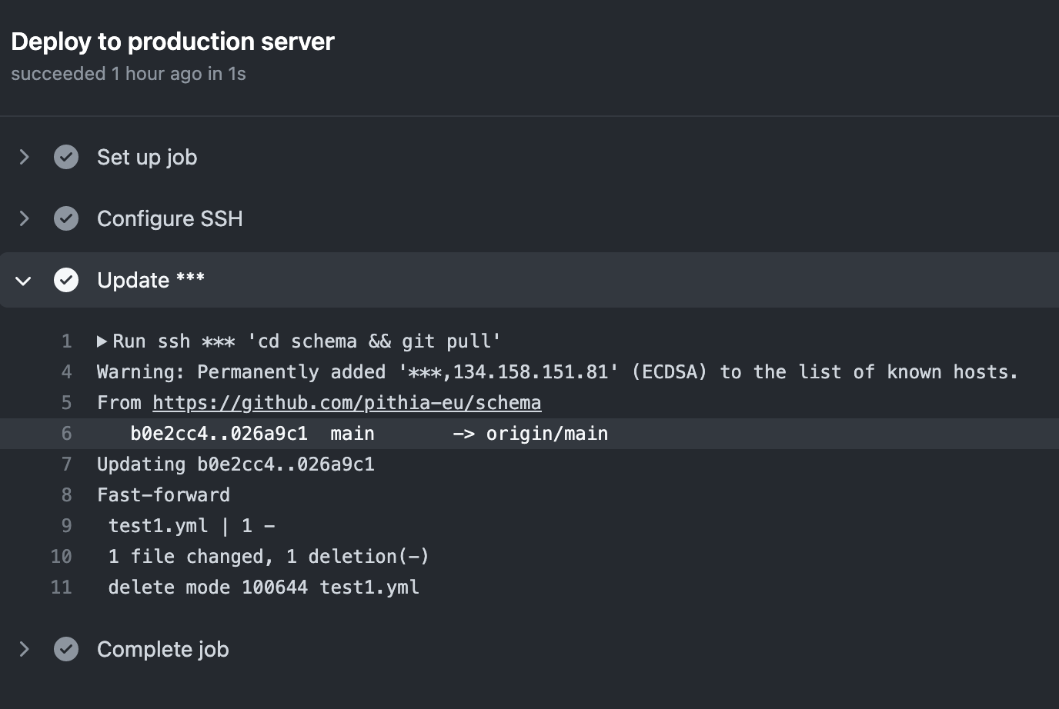
Updating the Schema Repository [GitHub side]
Repository URL: https://github.com/pithia-eu/schema [private repo]
The repository has a workflow that whenever someone makes changes, the schema server vm3.pithia.eu pulls those changes.
Required configurations:
The server vm3.pithia.eu has a local user metadata [no admin rights] with SSH privileges.
A GitHub user ‘pithiarepos’ associated with my uni email has a token that can clone that repo.
Three GitHub secrets where created Host, User, Metadata key, so that GitHub actions can ssh as metadata@vm3.pithia.eu.
A workflow created for the SCHEMA repo that SSH and pulls the changes on the server vm3.pithia.eu, at path /home/metadata/schema.

Slide 7
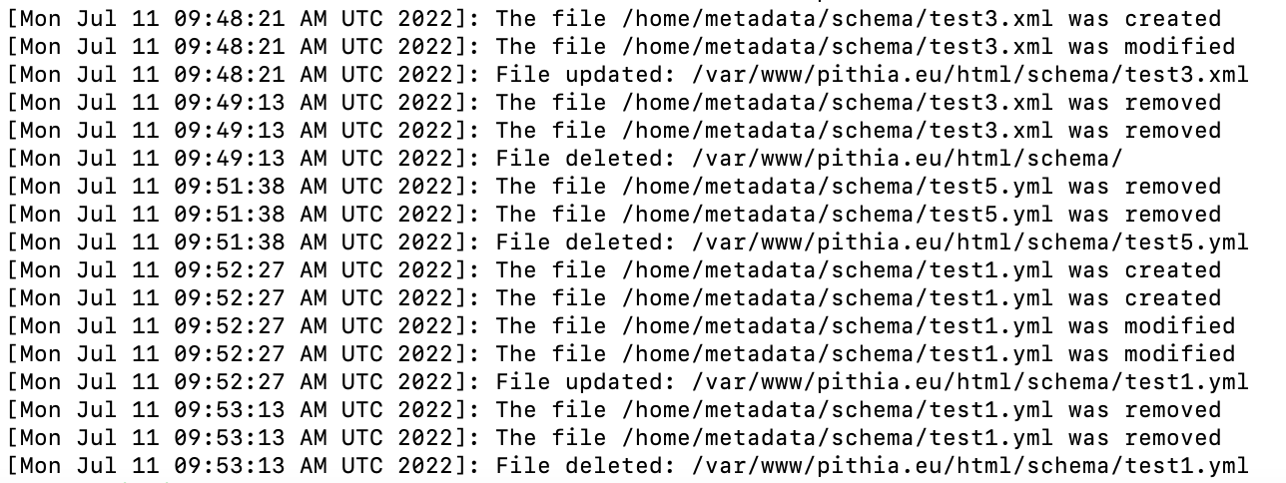
Updating the Schema Endpoint [Server vm3 side]
Endpoint URL: https://metadata.pithia.eu/schema/
The server has a script that runs on the background which updates the files at /var/www/pithia.eu/html/schema when changes are made in the repo /home/metadata/schema.
Configuration:
The script utilises the inotifywait monitoring tool to track changes in path /home/metadata/schema excluding the .git folder.
When a create, modify, delete action happens the script deletes to associated file from the www dir and copies the new files.
All action are being reported in a log file.

Slide 8
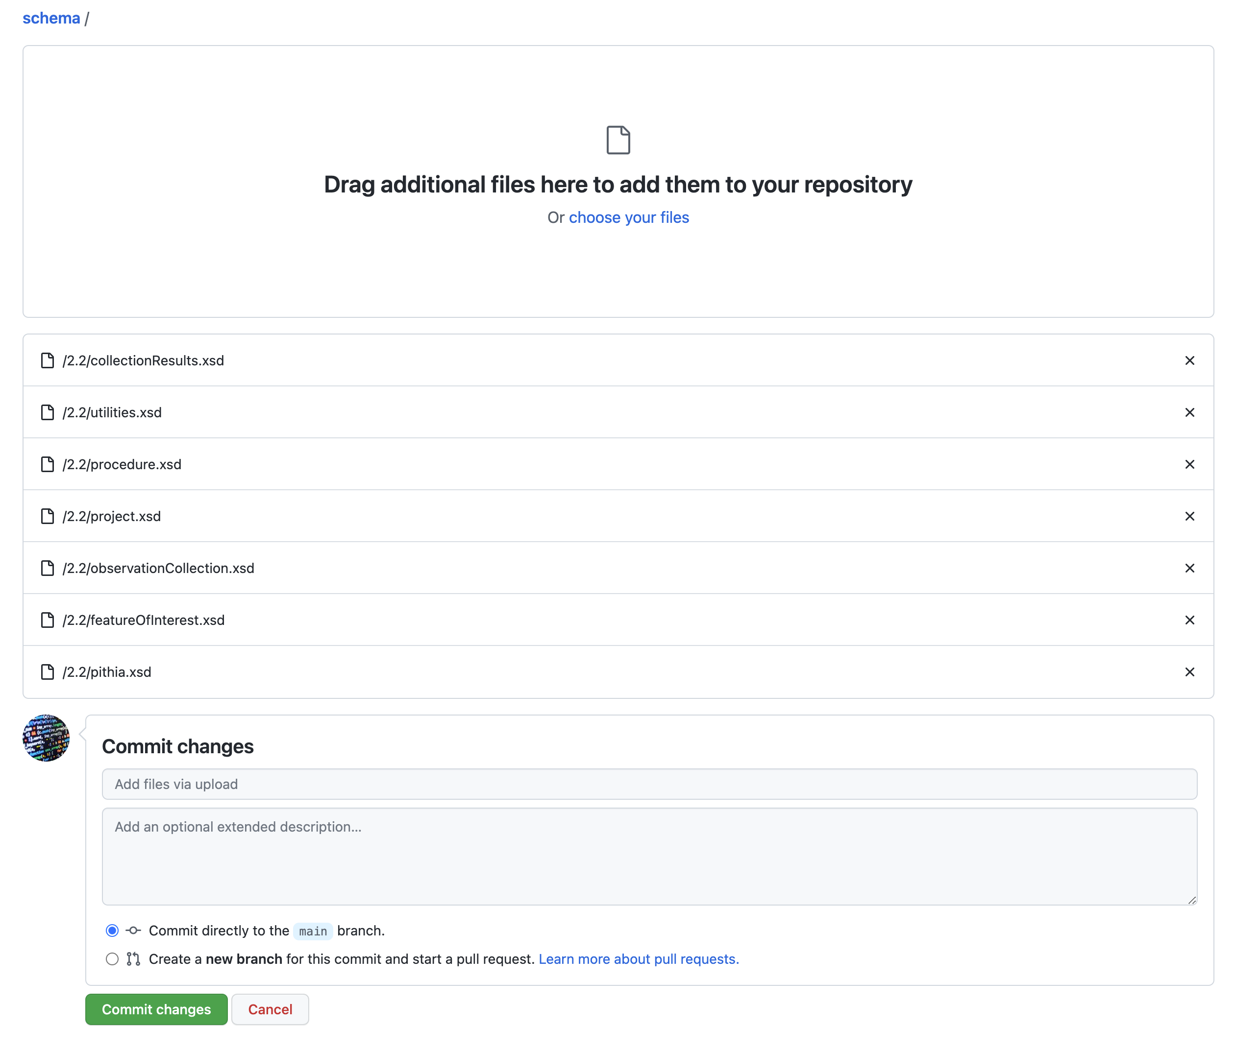
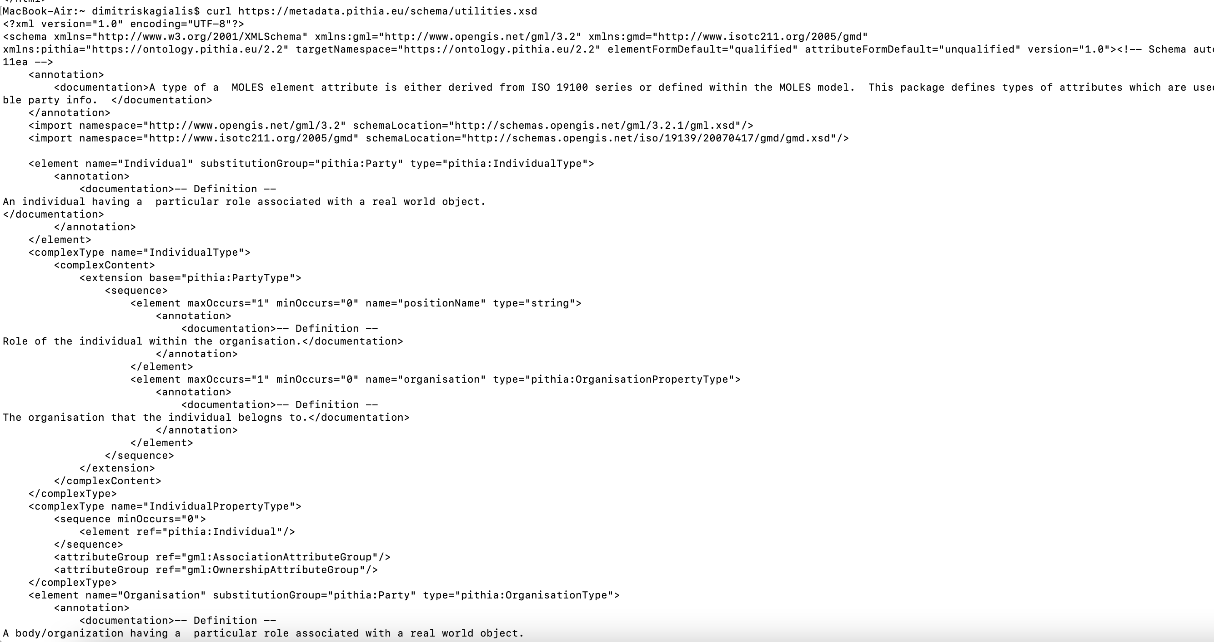
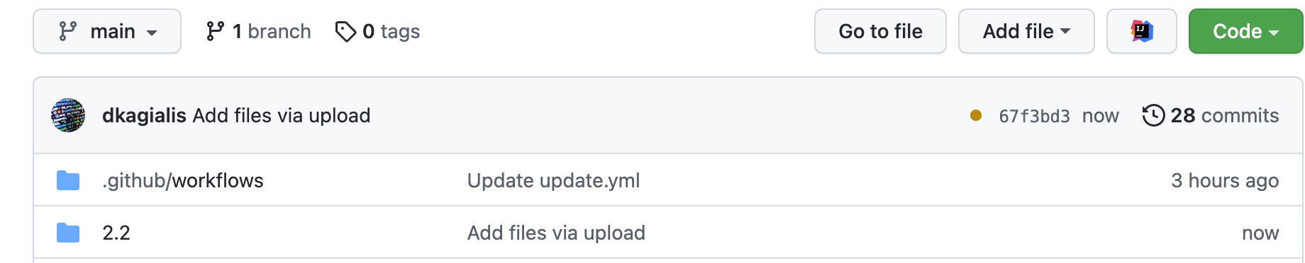
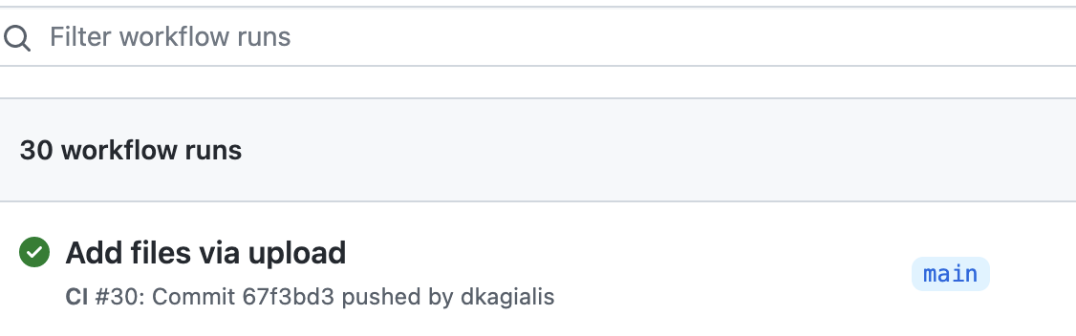
Temp schema files are up and running..
3 the files has been copies to the schema www folder
1 drug and drop the schema folder
4 XDS files are now published.
Sample request: curl https://metadata.pithia.eu/schema/utilities.xsd
2 the process has been initiated
Note: This is a PoC and I copy the files at the schemas root folder. I can apply a fix to the monitoring script to keep tree structure.

